Slide 1
Ethical Hacking
Internship
Task 3 Submission

Slide 2
Report
Vulnerability: "DOM Based XSS"
DOM-based XSS vulnerabilities usually arise when JavaScript takes
data from an attacker-controllable source, such as the URL, and
passes it to a sink that supports dynamic code execution.
This enables attackers to execute malicious JavaScript, which
typically allows them to hijack other users' accounts.
Host Name: http://testasp.vulnweb.com/
Operating System: Windows 11/64 bit
Port: 80/tcp
Threat Status: High (Critical)

Slide 3
Steps: 1) Visit the website http://testasp.vulnweb.com/
2) Click on the search option and the search box will be prompted.
3) In the search input field, write the payload ">svg onload=alert(1)>
4) An alert message box containing '1' wll be displayed.
Solutions: 1) Avoid allowing data from any untrusted source to dynamically alter
the value that is transmitted to any sink.
2) If you want to use user input to write in a 'div tag' element don't use
'innerHtml', instead use 'innerText' or 'textContent'.
The screenshots containing the vulnerability proof are attached below.

Slide 4


Slide 5
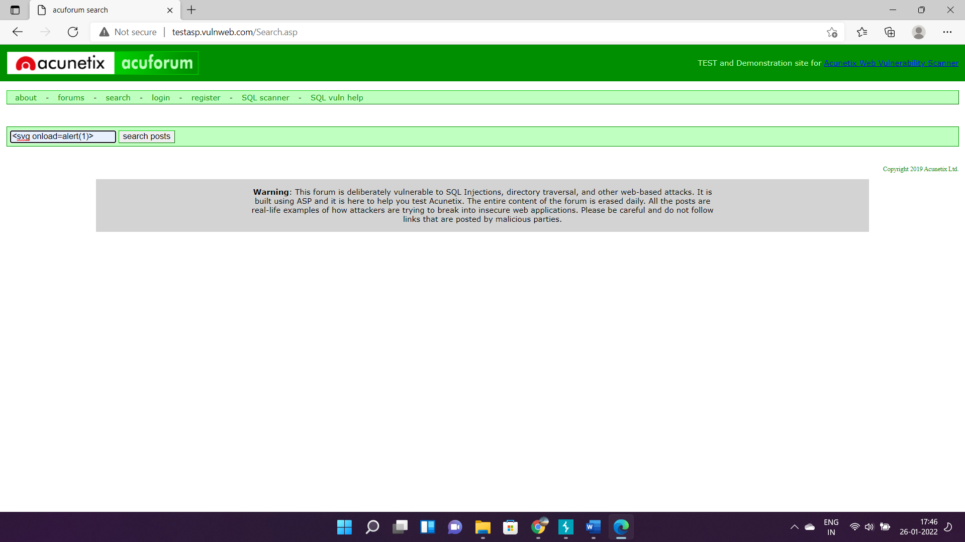

Slide 6
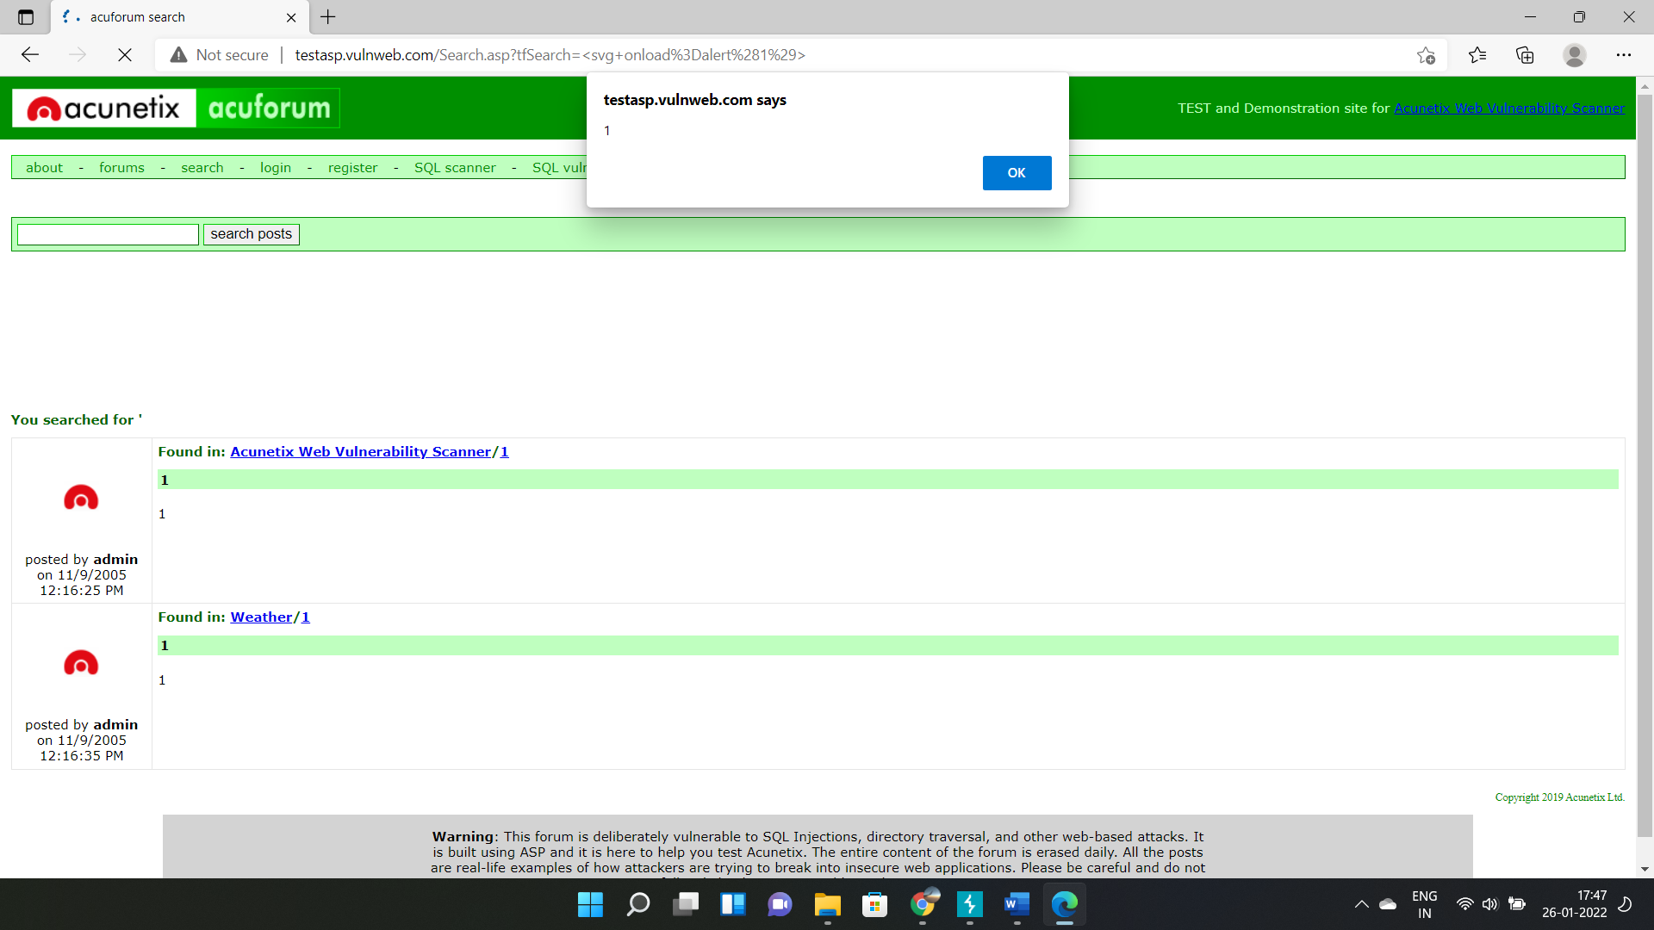

Slide 7
Thank You

